Slide 1
Git & GitHub Tutorial
What is GitHub and how does it relate to Git ?
Start!

Slide 2


About US :
1
2
3
Ilyas HAMDAOUI
Badr AZAOU
Students at FSSM : SMI-S6
4

Slide 3
Contents of This Workshop
1
1. Overview
6 min
VCS
Git GitHub
14 min
2
2. Installaing ➔ Get Started
Installing
Get started with Git Bash and Git Desktop
20 min
20 min
3. Workshop
3
Create your Project on github
Collaborative Project
25 min
25 min
4. QA ➔ Simple Competition
15 min
10 min
4
Questions
Tools for team working
Refresh Your Memory
10 min

Slide 4
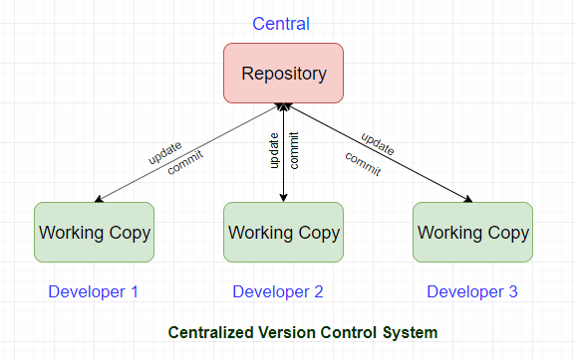
VCS
1
Problem :
2
Solution :
VCS stands for :
version control system
3
Software tool that helps developers manage changes to their code over time.
Manage branches and merges, and collaborate with other developers
4

Slide 5


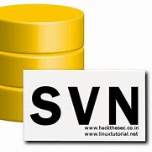
Popular CVS
1
Git
SVN
Mercurial
2
3
Distributed vs Centralized
Branching and Merging
Speed
Popularity and Community
4

Slide 6
Git & GitHub
1
Git
GitHub
2
Git is a revision contol system, a tool to manage your source code history.
GitHub is a hosting service for Git repositories.
V/S
3
GitHub is a web-based Git repository hosting service, which offers all of the distributed revision control and source code management (SCM) functionality of Git as well as adding its own features."
So they are not the same thing: Git is the tool, GitHub is the service for projects that use Git.
4

Slide 7
Benifits of Git and GitHub
Significant Benefits :
Saves Time
Undo Mistakes
Save Your Progress
Offline Working
Track Changes

Slide 8
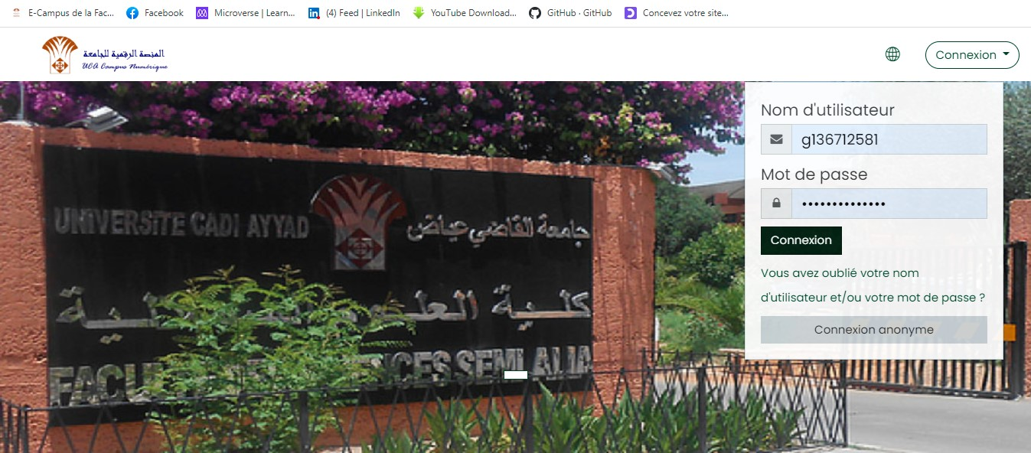
Repesitories :
Remote : Repositories live on Gihub Server .
push
Someone else’s talks to the
Github server with terminal
pull
push
pull
Browsers let’s you access
repository and send changes
Back to the server.
Your Local computer talks to the
Github server with terminal

Slide 9
2. Installing
1
Installing Git:
2
Go to the Git website: https://git-scm.com/
Download the appropriate installer for your operating system (Windows, Mac, or Linux)
3
Run the installer and follow the on-screen instructions to install Git on your computer.
After installation, open a terminal or command prompt and type :
git –version
4

Slide 10
2. Installing
1
Setting up a GitHub account :
1
2
3
Fill out the registration
form and create username and password.
2
Click on the "Sign up“
button in the top right corner.
Go to the GitHub website: https://github.com/
4
5
3
Choose a plan for your account (you can select the free plan for public repositories).
Follow the on-screen instructions to verify your email address.
4

Slide 11
2. Installing
1
Connecting Git to your GitHub account:
1
1
Open a terminal or command prompt and type :
git config --global user.name "Your Name“
To set your name for Git
Open a terminal or command prompt and type :
git config --global user.name "Your email“
To set your email for Git
2
3
4
5
Go to your GitHub account and create a new repository
Copy the repository URL.
In your terminal or command prompt, navigate to the directory where you want to store your local copy of the repository.
3
6
7
Type :
git clone <repository URL>
to clone the repository to your local machine.
You can now use Git to manage your files and push changes to your GitHub repository.
4

Slide 12
Life cycle of files in a repository: from changes to staging area
Untracked
Unmodified
Modified
Staged
Add the file
Edit the file
Stage the file
Remove the file
Commit

Slide 13
Basic Commands
git init : initializes a new Git repository in the current directory.
git add <filename> : stages changes to a file for inclusion in the next commit.
git commit -m "Commit message": creates a new commit with the changes that have been staged. → -a
git status : shows the current state of the repository, including any changes that have been made but not yet committed.
git push <remote> <branch>: pushes the changes in the specified branch to the remote repository.
git log: shows the commit history for the repository.
git clone: create a copy of a Git repository on your local machine.

Slide 14

Create Your first Project on Github :
M
Random selection : 1 person
file:///C:/Users/Thinkpad/Desktop/Work/JS-List-Projects/randomNumber_minMax/index.html
T
W
T
F

Slide 15
Branching :
M
Each repository by default has a "master" branch where all your work lives,
● Sometimes useful to create separate branches in your repository (to test new features, separate work among collaborators, etc.)
T
Keep working on new feature
W
start new feature
T
first commit
changes
more changes
Fix bug
merge
F

Slide 16
Basic Branching Commands :
M
T
git branch : lists all of the branches in your repository, but has a few other variations :
git branch <branch> : Creates a new branch with the given name
W
git branch -d <branch> : Deletes the specified branch
git checkout <branch> : Switches from the current branch to the specified branch (must already exist)
T
Option –b : First creates a new branch with the given name, then switches to it
git merge : Merge the specified branch to the current branch
F

Slide 17
Collaborative Project on Github :
M
Random selection : 2 person
file:///C:/Users/Thinkpad/Desktop/Work/JS-List-Projects/randomNumber_minMax/index.html
T
W
T
F

Slide 18

Refresh Your Memory :
1
2
3
4

Slide 19



Any Questions :
1
Tools for team and collaboration working :
2
GitHub
3
Figma
4

Slide 20
Any Questions :
1
Q
2
Go Ahead!
&
A
3
4

Slide 21

C/C
😊
😊
It's appreciated that you're here.
😊
😊

